Slide 1
Tailoring, Models, Methods, and Artifacts
SE423: Software Project Management

Slide 2
Outline
Tailoring
Models, Methods, and Artifacts

Slide 3
Tailoring

Slide 4
Tailoring
Tailoring is the deliberate adaptation of the project management approach, governance, and processes to make them more suitable for the given environment and the work at hand.
In a project environment, tailoring considers the development approach, processes, project life cycle, deliverables, and choice of people with whom to engage.

Slide 5
Tailoring
Tailoring involves understanding the project context, goals, and operating environment.
Projects operate in complex environments that need to balance potentially competing demands that include, but are not limited to:
Delivering as quickly as possible,
Minimizing project costs,
Optimizing the value delivered,
Creating high-quality deliverables and outcomes,
Providing compliance with regulatory standards,
Satisfying diverse stakeholder expectations, and
Adapting to change.

Slide 6
Why Tailor?
Tailoring is performed to better suit the organization, operating environment, and project needs.
Many variables factor into the tailoring process, including the criticality of the project and the number of stakeholders involved.
Using these variables as an example, it is evident that the rigor, checks and balances, and reporting required for a critical project (e.g., building a nuclear reactor) are much greater than those for building a new office building.

Slide 7
Why Tailor?
Tailoring produces direct and indirect benefits to organizations.
These include, but are not limited to:
More commitment from project team members who helped to tailor the approach,
Customer-oriented focus, as the needs of the customer are an important influencing factor in its development, and
More efficient use of project resources.

Slide 8
What to Tailor?
Project aspects that can be tailored include:
Life cycle and development approach selection,
Processes,
Engagement,
Tools, and
Methods and artifacts.

Slide 9
What to Tailor?
Project aspects that can be tailored include:
Life cycle and development approach selection,
Deciding on a life cycle and the phases of the life cycle is an example of tailoring.
Additional tailoring can be done when selecting the development and delivery approach for the project.
Some large projects may use a combination of development and delivery approaches simultaneously.
For instance, building a new data center could involve
(a) the use of predictive approaches for the physical building construction and finishing and
(b) an iterative approach for understanding and establishing the computing capabilities required.
Viewed from a project level, this combination of approaches represents a hybrid approach, but the construction team and the computing team may only experience a predictive or iterative development approach.

Slide 10
What to Tailor?
Project aspects that can be tailored include:
Processes,
Process tailoring for the selected life cycle and development approach includes determining which portions or elements should be:
Added
Modified
Removed
Blended
Aligned

Slide 11
What to Tailor?
Project aspects that can be tailored include:
Engagement,
Tailoring engagement for the people involved in the project includes:
People
Empowerment
Integration

Slide 12
What to Tailor?
Project aspects that can be tailored include:
Tools
Selecting the tools (e.g., software or equipment) the project team will use for the project is a form of tailoring.
Often, the project team has the best insight into the most suitable tools for the situation, but those choices might need tempering based on the associated costs.
Additionally, organizational leaders can impose constraints that the project team cannot change.

Slide 13
What to Tailor?
Project aspects that can be tailored include:
Methods and artifacts
Tailoring the means that will be used to achieve the project outcomes is performed so that the methods are suited for the environment and the culture.
Tailoring the documents, templates, and other artifacts that will be used on the project helps to make sure the artifacts are appropriate for the project and the organization.

Slide 14
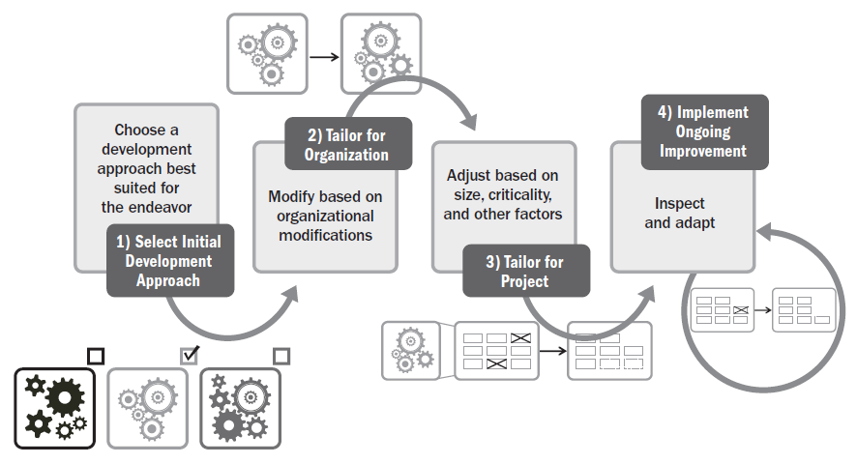
The Tailoring Process

Slide 15
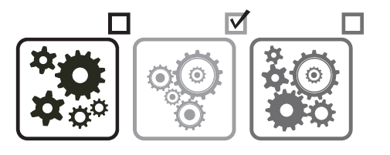
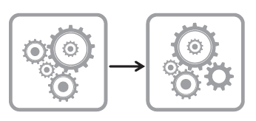
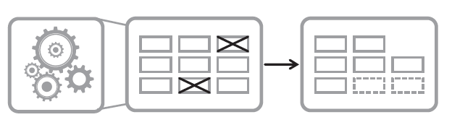
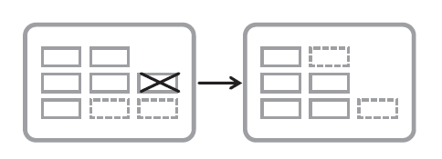
Selecting the Initial Development Approach
Selecting the Initial Development Approach
Tailoring the Approach for the Organization
Tailoring the Approach for the Project
Implement Ongoing Improvement

Slide 16
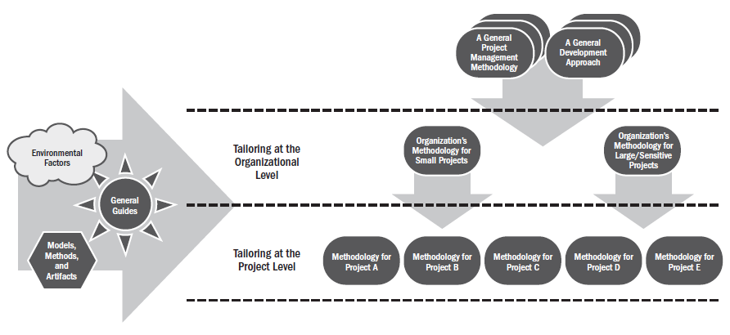
Assessing the Organizational and Project Factors When Tailoring

Slide 17
Tailoring for the Project
Many attributes influence tailoring for the project.
These include, but are not limited to:
Product/deliverable,
Project team, and
Culture.

Slide 18
Tailoring for the Project
Product/Deliverable
Attributes associated with the product or deliverable include, but are not limited to:
Compliance/criticality
Type of product/deliverable
Industry market
Technology
Time frame
Stability of requirements
Security.

Slide 19
Tailoring for the Project
Project Team
Project team considerations include:
Project team size
Project team geography
Organizational distribution
Project team experience
Access to customer

Slide 20
Tailoring for the Project
Culture
Evaluating the culture includes considerations regarding:
Buy-in
Trust
Empowerment
Organizational culture

Slide 21
Implement Ongoing Improvement
The process of tailoring is not a single, one-time exercise.
During progressive elaboration, issues with how the project team is working, how the product or deliverable is evolving, and other learnings will indicate where further tailoring could bring improvements.
Review points, phase gates, and retrospectives all provide opportunities to inspect and adapt the process, development approach, and delivery frequency as necessary.

Slide 22
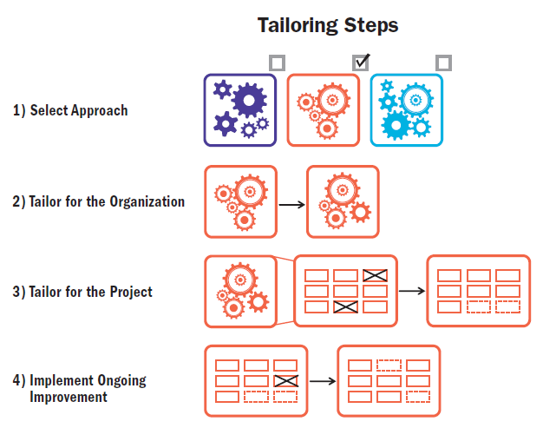
The Tailoring Process

Slide 23
Tailoring the Performance Domain
Some tailoring considerations related to each of the performance domains include, but are not limited to:
Stakeholders
Project Team
Development Approach and Life Cycle
Planning
Project Work
Delivery
Uncertainty
Measurement

Slide 24
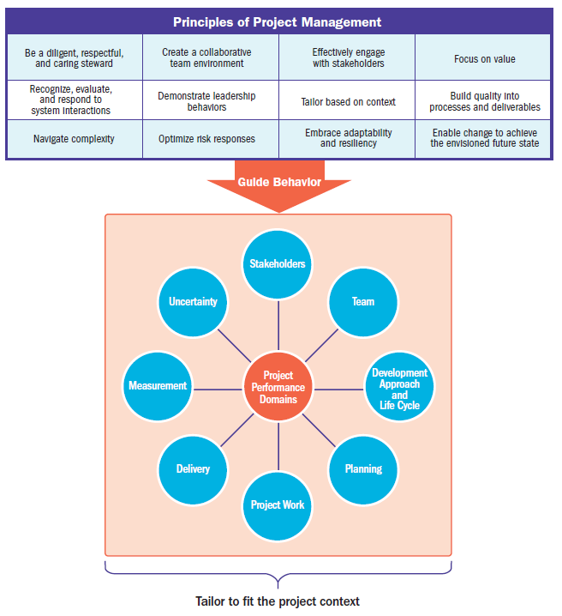

Slide 25
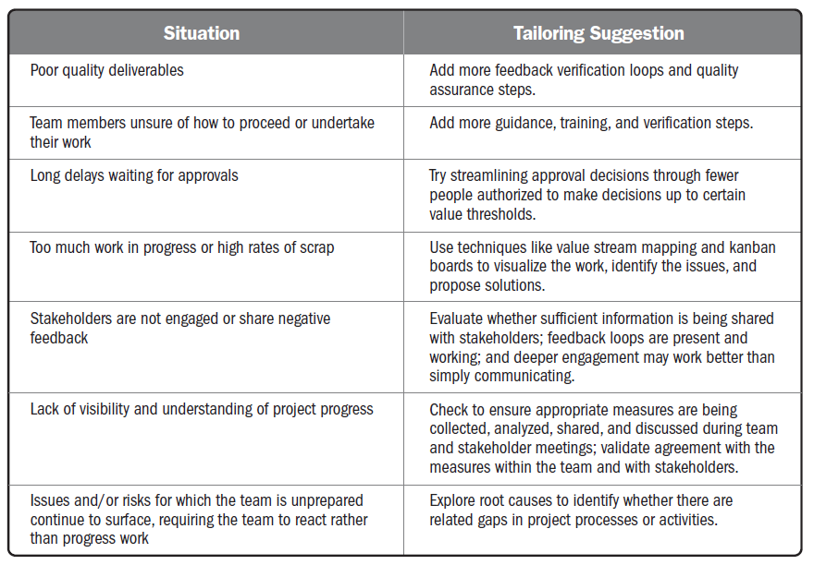

Slide 26
Summary
Tailoring involves the considered adaptation of approach, governance, and processes to make them more suitable for the given environment and the project at hand.
It involves the analysis, design, and deliberate modification of the people elements, the processes employed, and the tools used.
The tailoring process involves four steps:
Select initial approach
Tailor for the organization
Tailor for the project
Implement ongoing improvement

Slide 27
Models, Methods, and Artifacts

Slide 28
Models, Methods, and Artifacts
This section provides a high-level description of some commonly used models, methods, and artifacts that are useful in managing projects.
The items listed in this section are not intended to be exhaustive or prescriptive, but rather to help project teams think about the options available to them.

Slide 29
Models, Methods, and Artifacts
In the context of this guide, terms are defined as follows:
Model
A model is a thinking strategy to explain a process, framework, or phenomenon.
Method
A method is the means for achieving an outcome, output, result, or project deliverable.
Artifact
An artifact can be a template, document, output, or project deliverable.

Slide 30
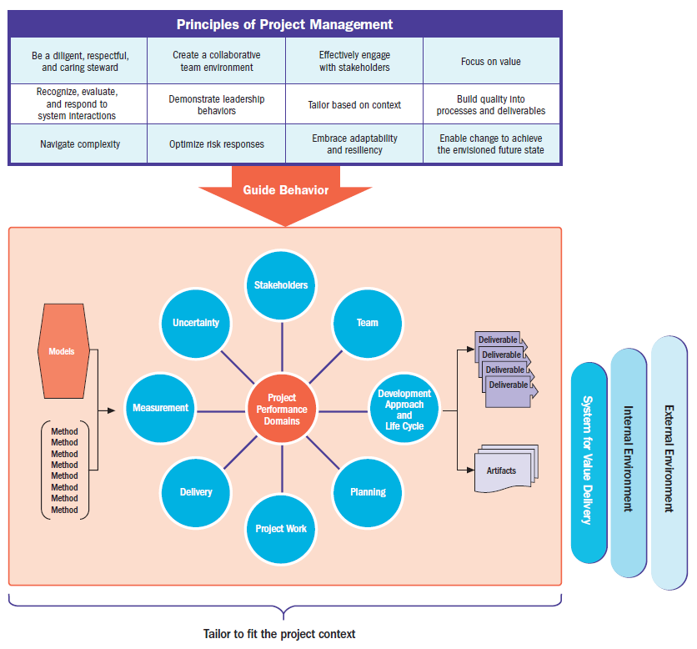

Slide 31
Models, Methods, and Artifacts
As with any process, the use of models, methods, and artifacts has associated costs related to time, level of expertise/proficiency in use, impact on productivity, etc.
Project teams should consider these implications when deciding which elements to use.
As much as possible, project teams should avoid using anything that:
Duplicates or adds unnecessary effort,
Is not useful to the project team and its stakeholders,
Produces incorrect or misleading information, or
Caters to individual needs versus those of the project team.

Slide 32
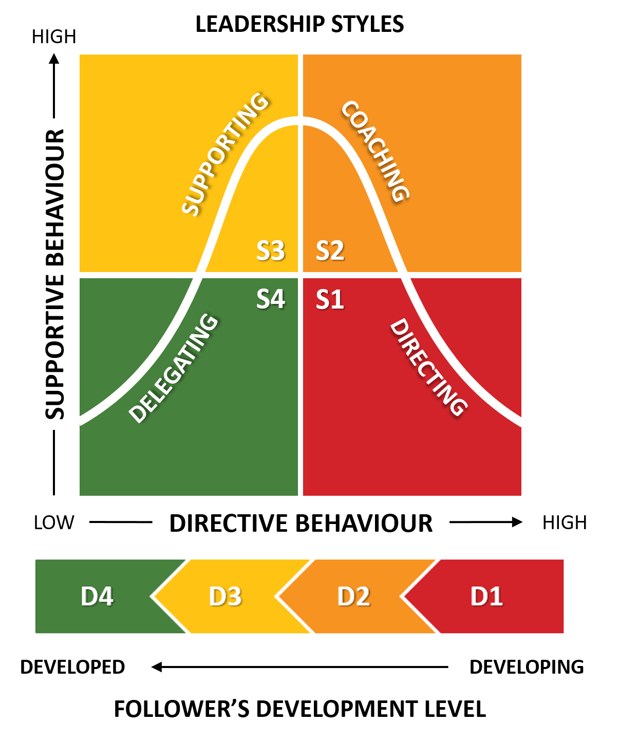
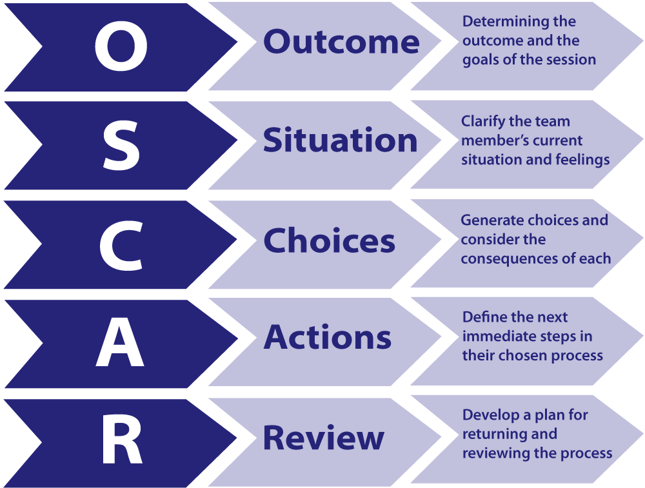
Commonly Used Models
Situational leadership models
Situational Leadership® II
OSCAR Model
Communication models
Cross-Cultural Communication
Effectiveness of Communication Channels
Gulf of Execution and Evaluation

Slide 33
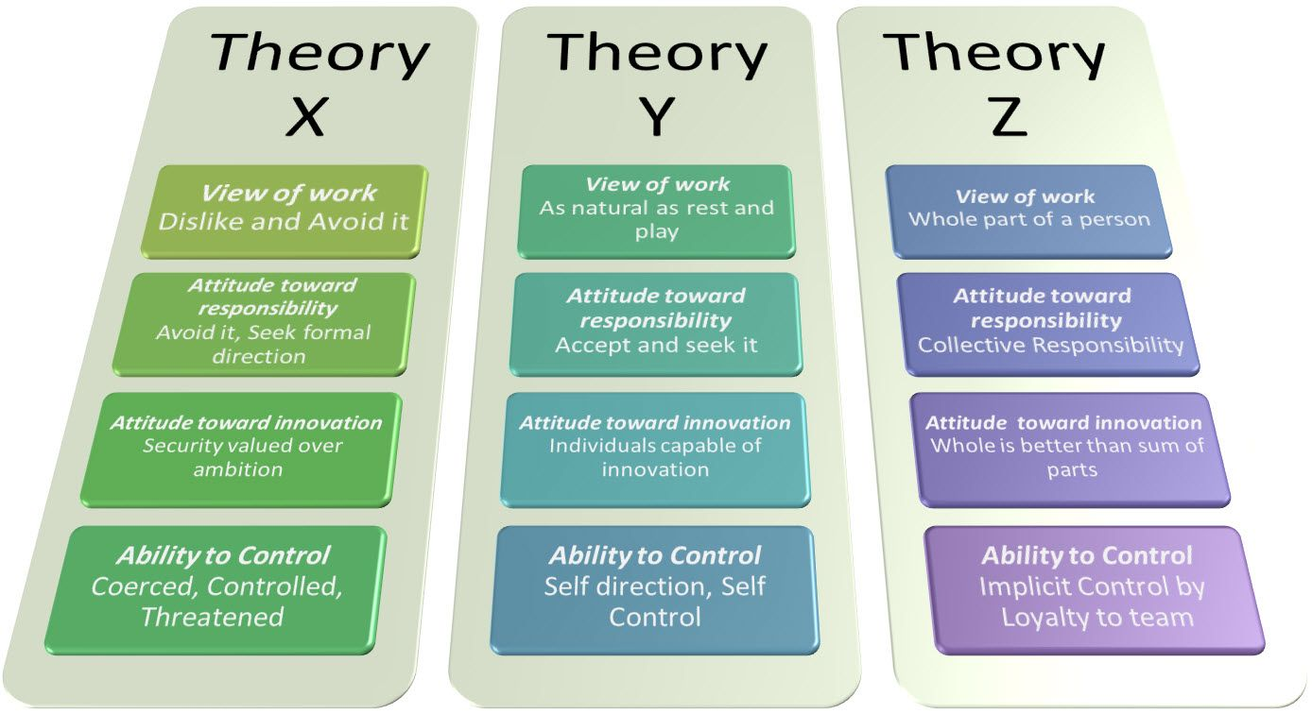
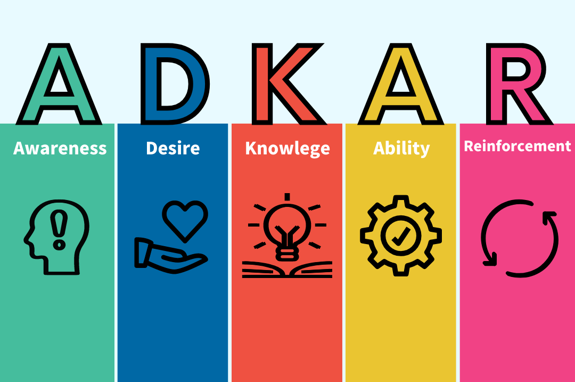
Commonly Used Models
Motivational models
Hygiene and Motivational Factors
Intrinsic versus Extrinsic Motivation
Theory of Needs
Theory X, Theory Y, and Theory Z
Change models
Managing Change in Organizations
ADKAR® Model
The 8-Step Process for Leading Change
Virginia Satir Change Model
Transition Model

Slide 34
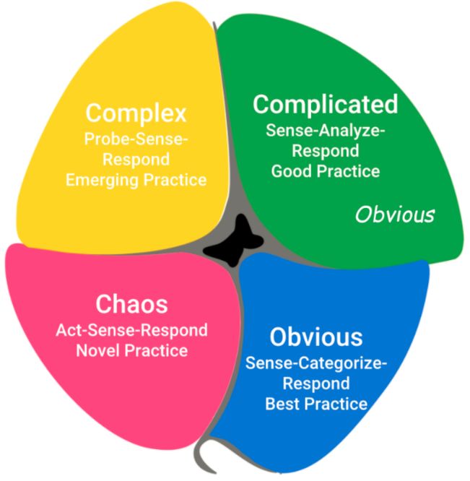
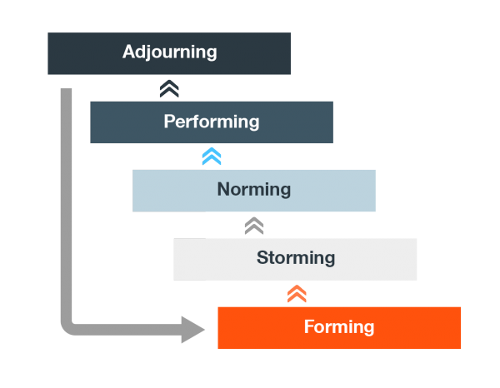
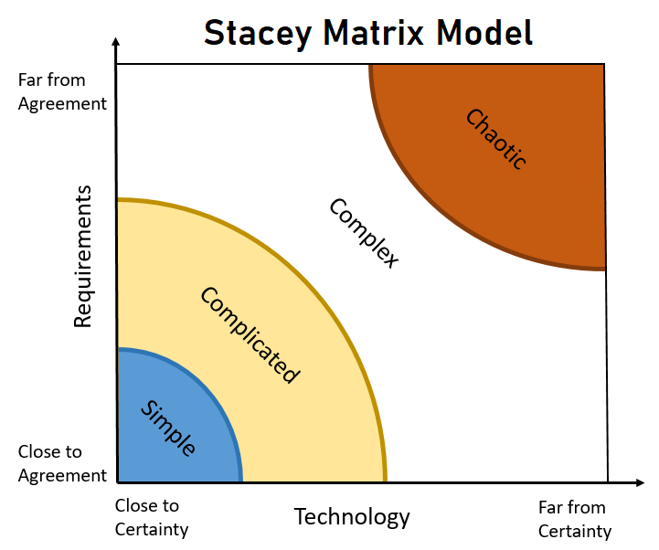
Commonly Used Models
Complexity models
Cynefin Framework
Stacey Matrix
Project team development models
Tuckman Ladder
Drexler/Sibbet Team Performance Model

Slide 35
Commonly Used Models
Other models
Conflict Model
Negotiation
Planning
Process Groups
Salience Model

Slide 36
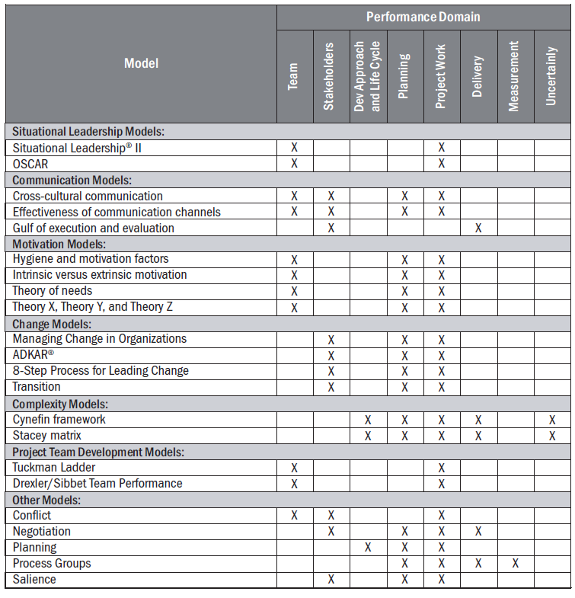

Slide 37
Commonly Used Methods
Data gathering and analysis
Estimating
Meetings and events
Other methods

Slide 38
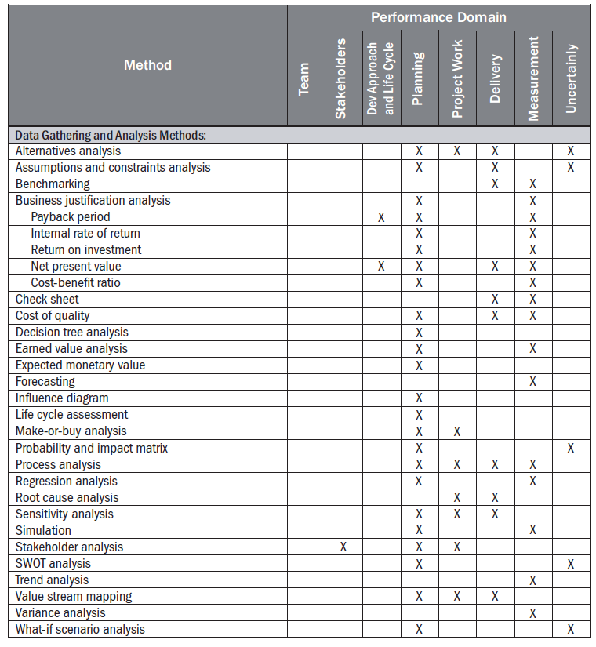

Slide 39
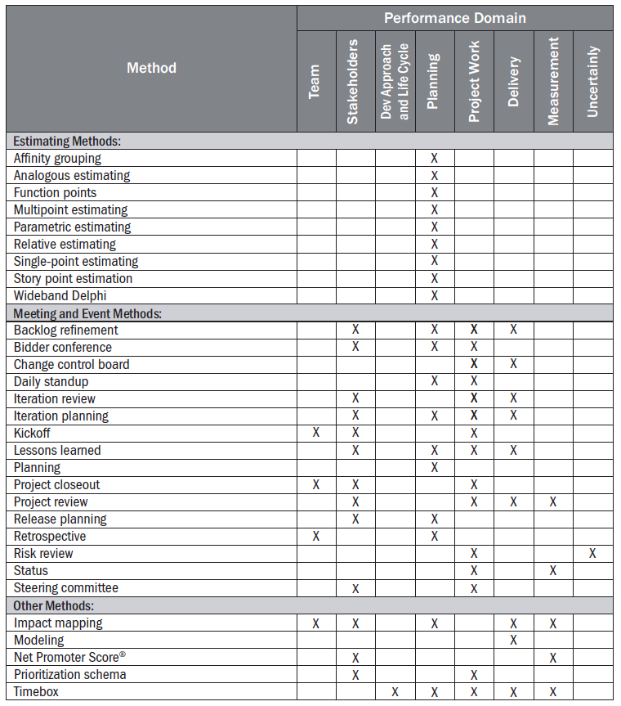

Slide 40
Commonly Used Artifacts
Strategy Artifacts
Logs and registers
Plans
Hierarchy charts
Baselines
Visual data and information
Reports
Agreements and contracts
Other artifacts

Slide 41
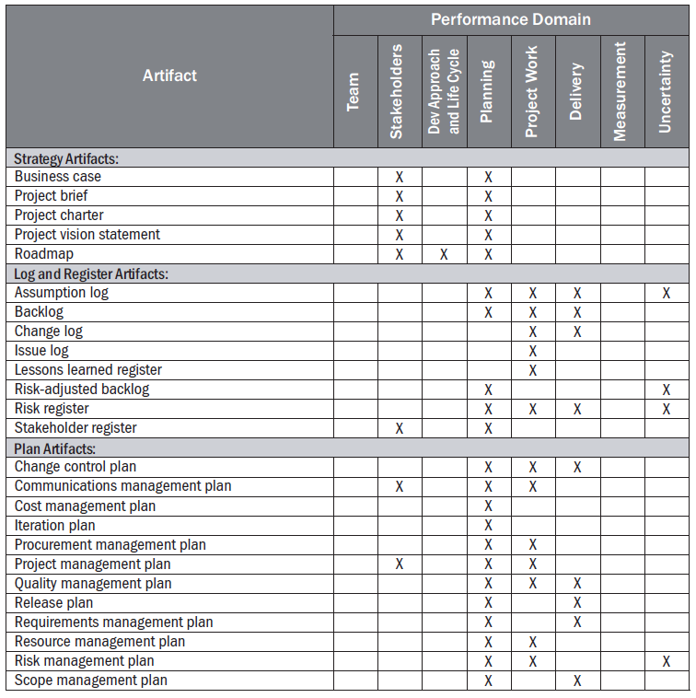

Slide 42
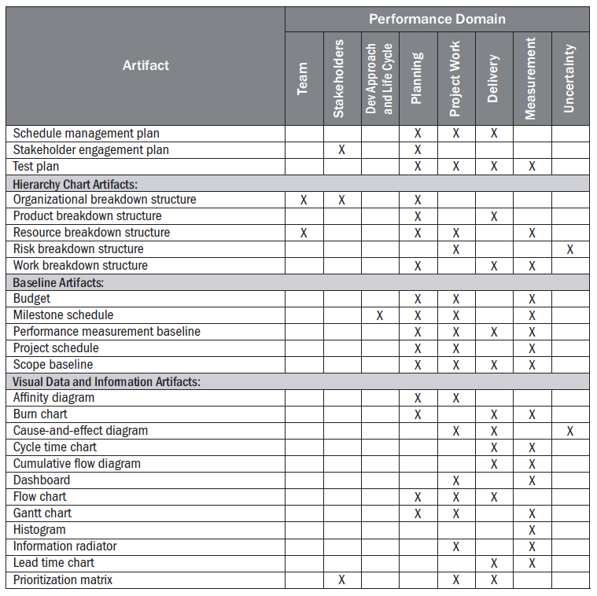

Slide 43
